Slide 1

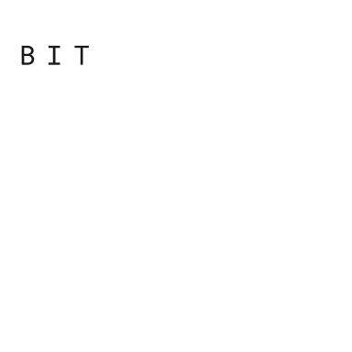
Programming
Principles
with JavaScript

Slide 2

Day Overview
Getting to Know Terminology
How Computers Work
Data Representation

Slide 3
Data Representation
Numerical Systems, ASCII, Unicode

Slide 4
Numerical Bases
Computing can be reduced to operating with numbers, because information is expressible in numbers.

Slide 5
Numerical Bases
Letters can be mapped to numbers, so text can be written numerically.
Colors are a combination of light intensities of red, blue and green, which can be given as numbers.
Images can be composed of mosaics of colored squares, so they can be expressed as numbers.

Slide 6
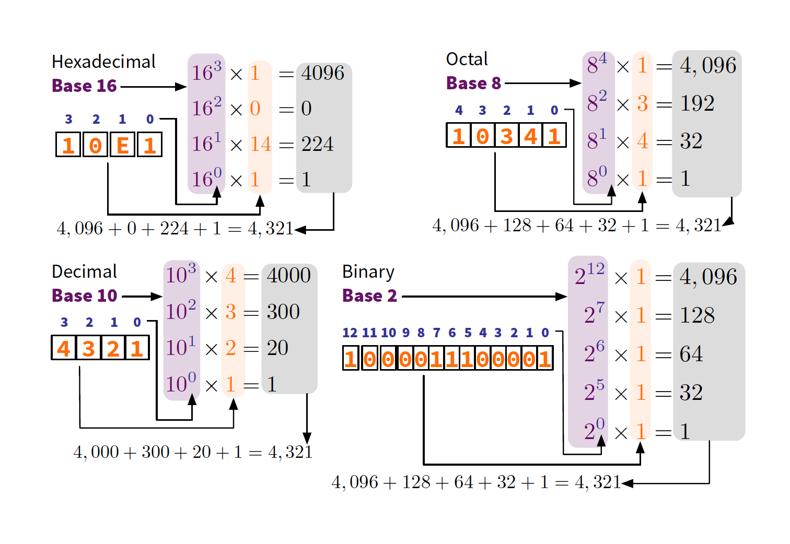
Numerical Bases

Slide 7
Natural (“human”) languages
Spoken form
Written form
Sign language
Language of computers
0 0 0 0 0 0 0 0
1 1 1 1 1 1 1 1
1 0 0 0 0 0 0 0
0 1 0 0 0 0 0 0
. . . . . . . .
1 1 1 1 1 1 1 1

Slide 8
At the lowest level, computer language is binary
This language has two alphabetic characters
Byte
Sequence of 8 bits
Byte is a number of bits used to encode
a single character or char
0 0 0 0 0 0 0 0
1 1 1 1 1 1 1 1
1 0 0 0 0 0 0 0
0 1 0 0 0 0 0 0
. . . . . . . .
1 1 1 1 1 1 1 1

Slide 9
To encode means to use something to represent something else.
An encoding is a set of rules with which to convert something from one representation to another.
character set, charset
The set of characters that can be encoded. Essentially synonymous to "encoding".
string
A string is a bunch of items strung together. A bit string is a bunch of bits, like 01010011. A character string is a bunch of characters, like this. Synonymous to "sequence".
Notes:
References
https://www.joelonsoftware.com/2003/10/08/the-absolute-minimum-every-software-developer-absolutely-positively-must-know-about-unicode-and-character-sets-no-excuses/
http://kunststube.net/encoding/

Slide 10
How to represent text with 0’s and 1’s?

Slide 11
010010000110010101101100011011000110111100100000011101110110111101110010011011000110010000100001
110 145 154 154 157 040 167 157 162 154 144 041
48 65 6c 6c 6f 20 77 6f 72 6c 64 21
Hello world!
Each character is mapped to a code point (character code), a unique integer.
H -> 72 _{dec}
e -> 101 _{dec}
Each code point is represented as a binary number, using a fixed number of bits
H -> 72 _{dec} -> 01001000 _{binary}
e -> 101 _{dec} -> 01100101
One byte can represent 256 (2⁸) different characters
00000000 -> 0 _{dec} 11111111 -> 255 _{dec}
Notes:
http://www.unit-conversion.info/texttools/convert-text-to-binary/

Slide 12
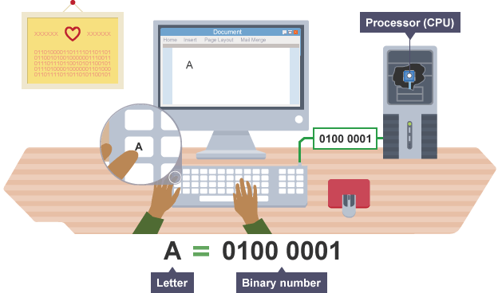

Slide 13
ASCII Encoding for English
How many bits do we need to encode English?
26 lower case letters: a, b, c, d, e...
26 upper case letters: A, B, C, D, E...
10 Arabic digits: 0, 1, 2, 3, 4...
Punctuation: . , : ; ? ! ' "
Symbols: ( ) < > & % * $ + -
6 bits (2⁶ = 64) is not enough; we will need at least 7 (2⁷ = 128)
=80

Slide 14
ASCII Encoding for English
ASCII (American Standard Code for Information Interchange) did just that
Uses 7-bit code (128 characters) for storing English text ranging 0 to 127
In an 8-bit (1 byte) representation, the highest bit is always 0
Includes 32 non-printing characters
Notes:
http://www.rapidtables.com/code/text/ascii-table.htm

Slide 15
What about characters used in other languages?

Slide 16
Extending ASCII: ISO-8859, etc.
Extend ASCII into 8-bit (256 characters) and use the additional 128 slots for non-English characters
ISO-8859: has 16 different implementations!
ISO-8859-1 (aka Latin-1: French, German, Spanish, etc.)
ISO-8859-7 (Greek alphabet)
ISO-8859-8 (Hebrew alphabet)
Problem: Overlapping characters
224_{dec} means à in Latin-1 but א in ISO-8859-8!
Multiple coding systems map different characters to the same character code

Slide 17
Solution 1
Provide meta-information on coding system
E.g. MIME (Multipurpose Internet Mail Extensions)
Mime-Version: 1.0 Content-Type: text/plain; charset=US-ASCII Content-Transfer-Encoding: 7bit
What if your message contains characters from multiple coding systems?
Notes:
Meta informacije su informacije koje daje podatke o drugim informacijama

Slide 18
Solution 2
Have a single universal code system for all writing systems -> UNICODE
A character encoding standard developed by the Unicode Consortium
Provides a single representation for all world's writing systems
Unicode provides a unique number for every character, no matter the platform, program, or the language.
Notes:
http://www.unicode.org

Slide 19
How big is Unicode?
Version 9.0 (2016) has codes for 128,237 characters
Full Unicode standard uses 32 bits (4 bytes): it can represent 2³² = 4,294,967,296 characters!
In reality, only 21 bits are needed
Notes:
http://www.unicode.org

Slide 20
How big is Unicode?
Unicode has three encoding versions:
UTF-32 (32 bits/4 bytes): direct representation
UTF-16 (16 bits/2 bytes): 2¹⁶=65,536 possibilities
UTF-8 (8 bits/1 byte): 28=256 possibilities
Advantage for English
8-bit ASCII is already a valid UTF-8!
Notes:
How to find your Unicode character:
http://www.unicode.org/standard/where/ http://www.unicode.org/charts/
Basic Latin (ASCII)
http://www.unicode.org/charts/PDF/U0000.pdf

Slide 21
Hexadecimal
Hexadecimal (hex) = base 16
Utilizes 16 characters:
0 1 2 3 4 5 6 7 8 9 A B C D E F
Designed for human readability & easy byte conversion
2⁴=16: 1 hexadecimal digit is equivalent to 4 bits
1 byte (=8 bits) is encoded with just 2 hex chars!

Slide 22
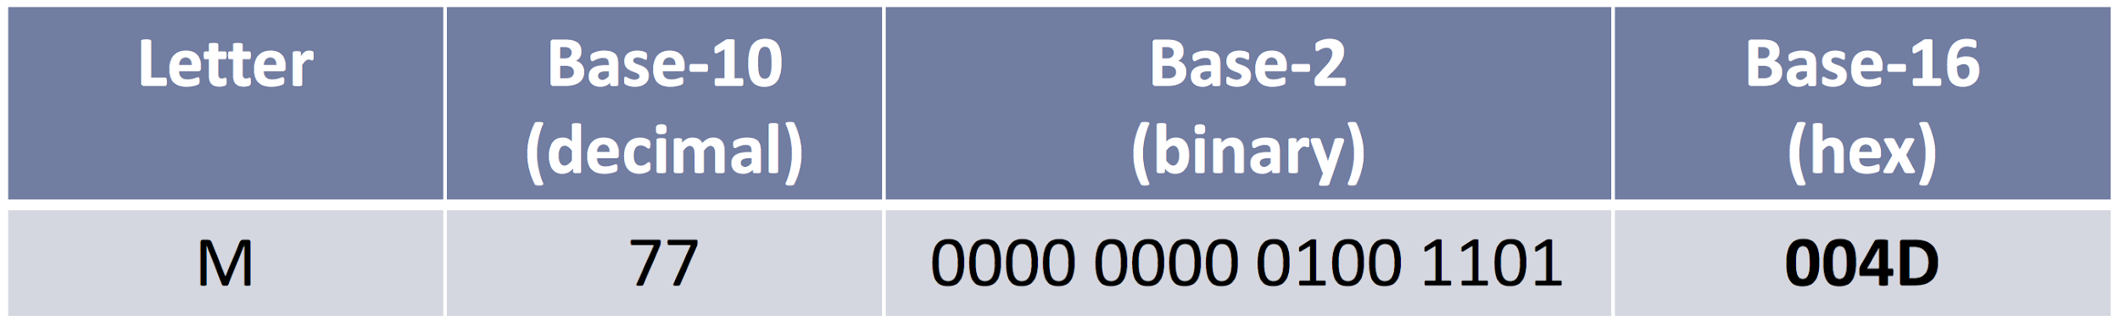
Hexadecimal
Unicode characters are usually referenced by their hexadecimal code
Lower-number characters go by their 4-char hex codes (2 bytes), e.g.
U+004D ("M", U+ designates Unicode)
Higher-number characters go by 5 or 6 hex codes
e.g. U+1D122
Notes:
http://www.unicode.org/charts/PDF/U1D100.pdf

Slide 23
